Slide 1
CSE-299 SEC-02 FALL’20
ILMIAT FARHANA
1712428042

Slide 2
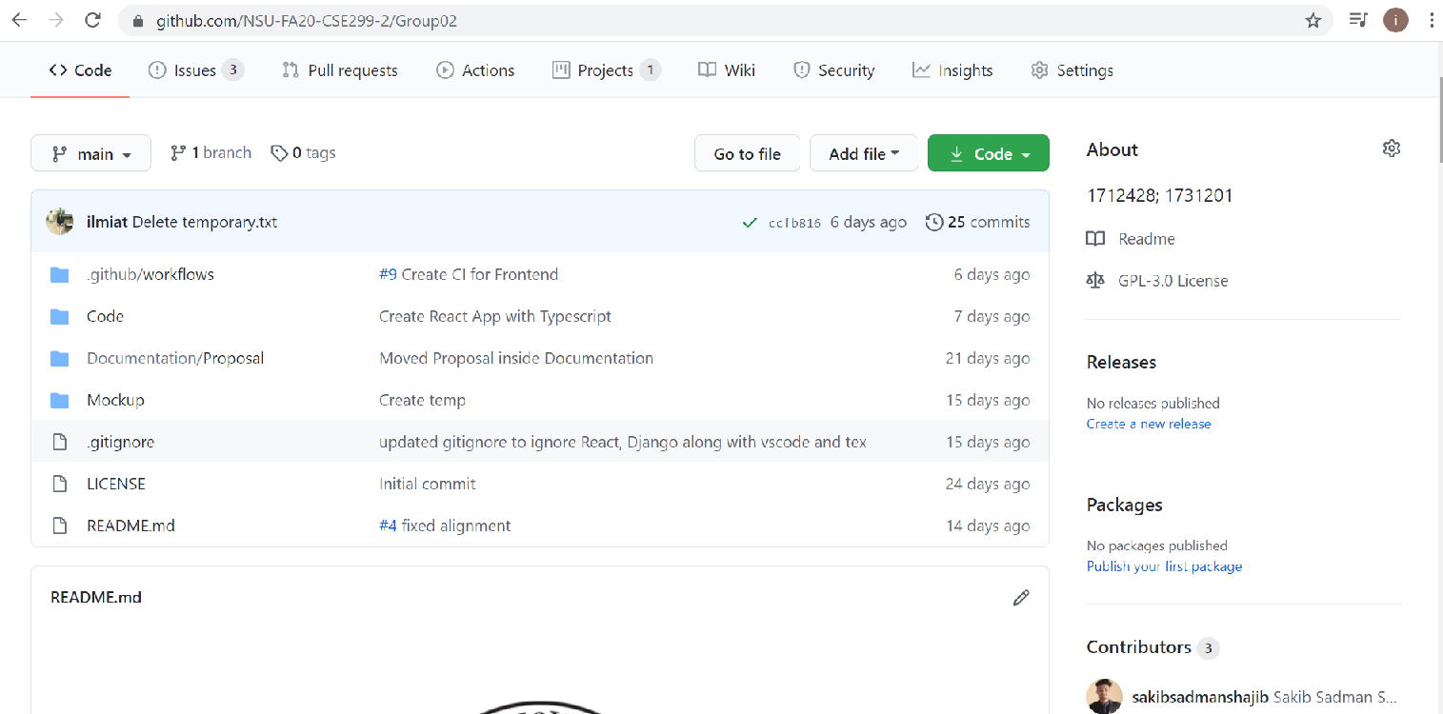
GIT FRONT PAGE

Slide 3
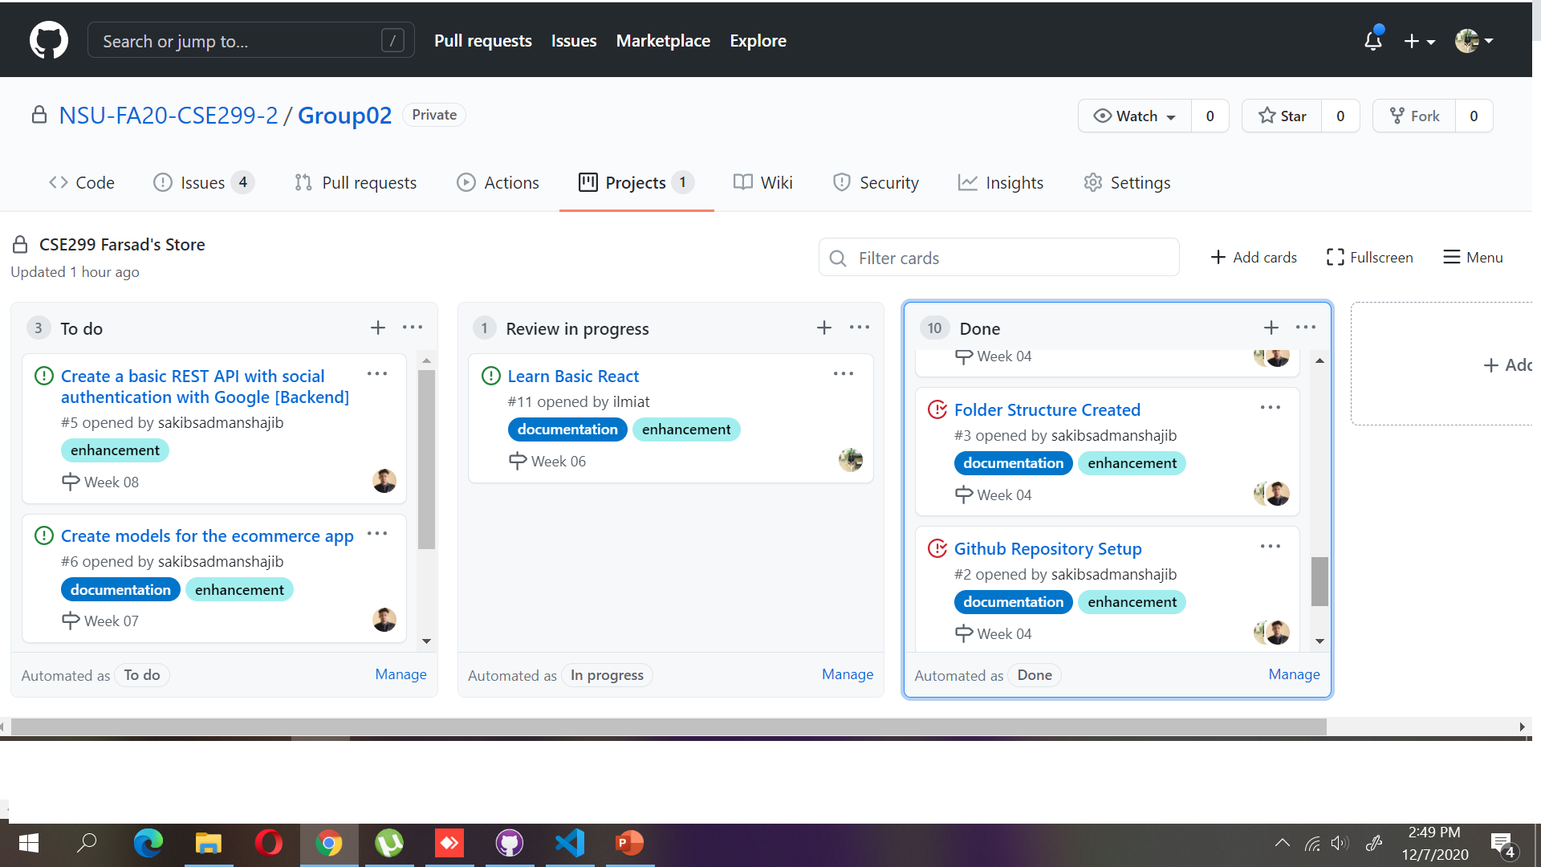
GIT BOARD

Slide 4
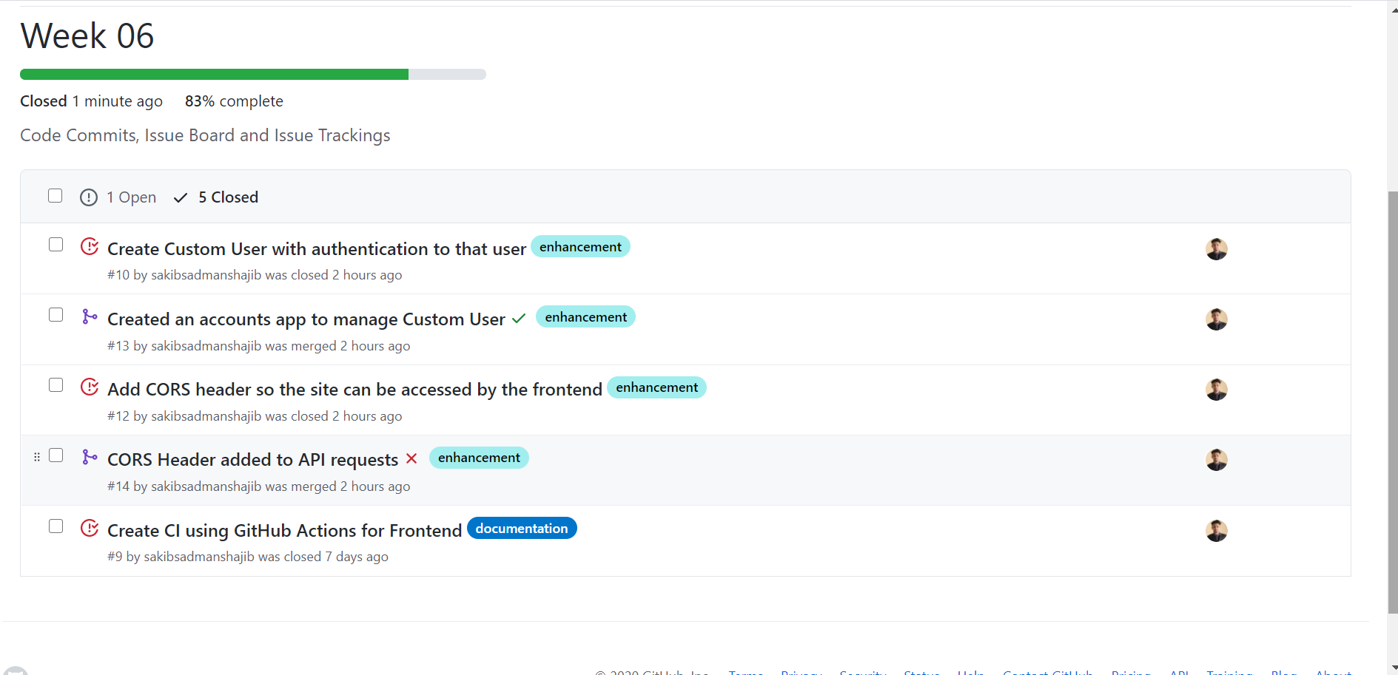
Week 06 Commits

Slide 5
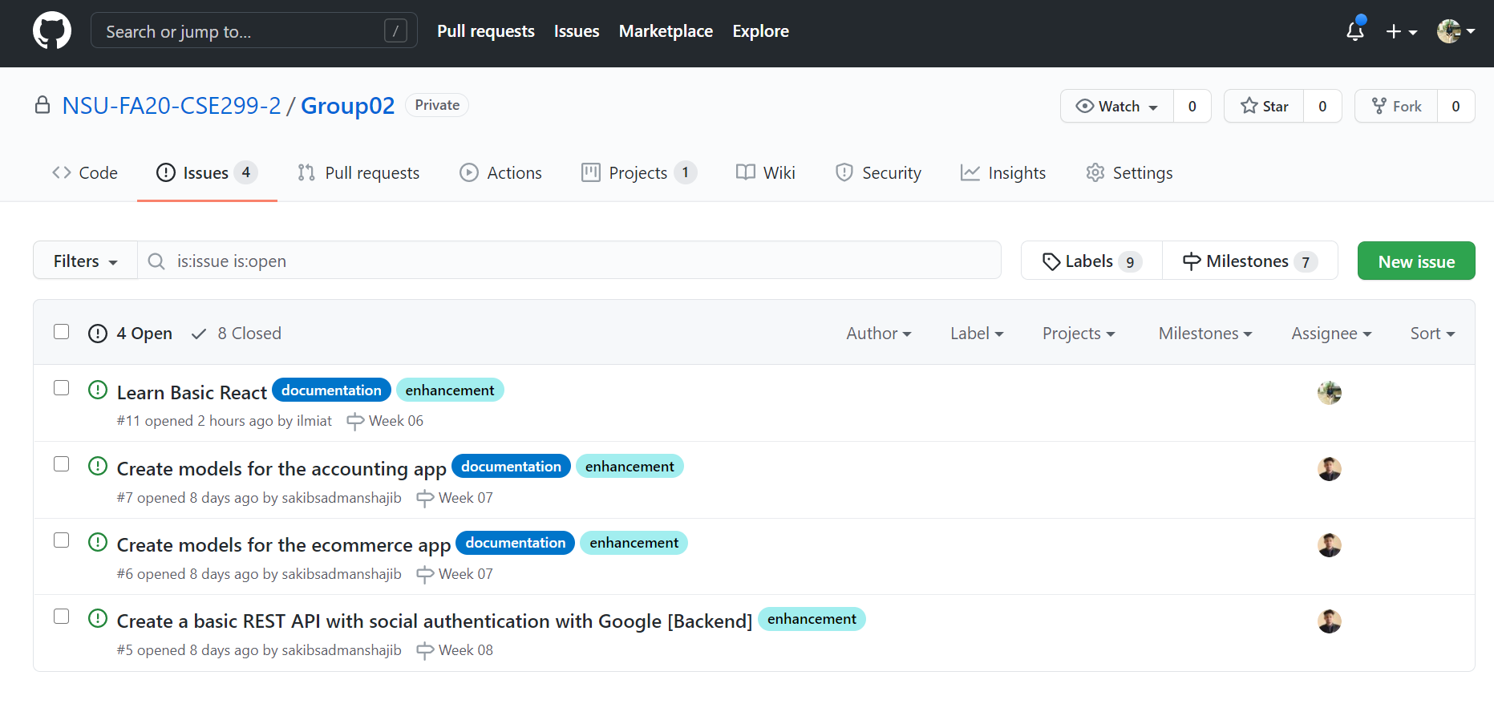
Issues:

Slide 6
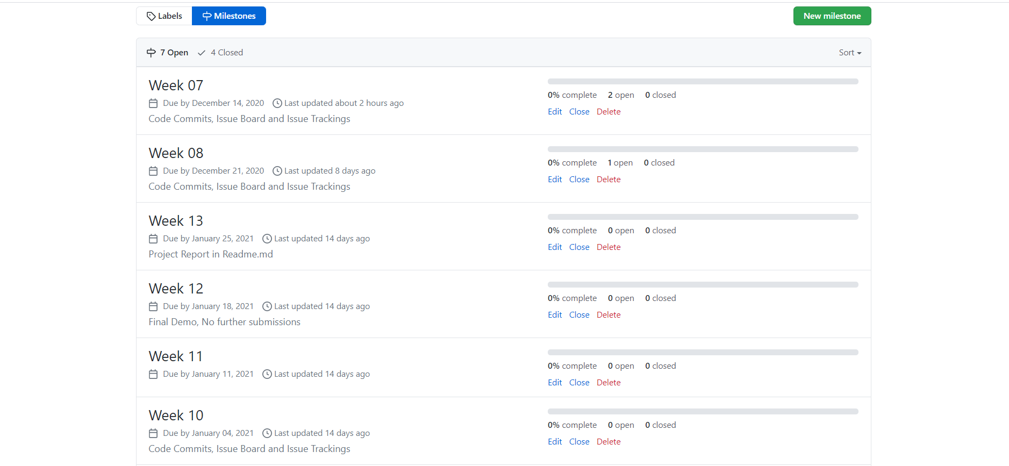
Milestones:

